Slide 1
Design and Implementation of Single Phase Solar Inverter Using Soft Switching Techniques
PE9231 PROJECT PHASE-II REVIEW
Present By
RAJASUNDRAPANDIYANLEEBANON (714011415008)
M.E POWER ELECTRONICS AND DRIVES
IV-SEMESTER
SIET
Guided By
R. ASHOK, M.S
Assistant Professor/EEE

Slide 2
Overview
System Design
Experimental Setup
Results and Discussion
Simulation
Conclusion

Slide 3
System Design

Slide 4
System Design
Solar Array
MPPT Boost Converter
Bus Converter
DC TO AC Inverter
Battery Charger
Load
Battery Charger
Battery
AC i/p

Slide 5
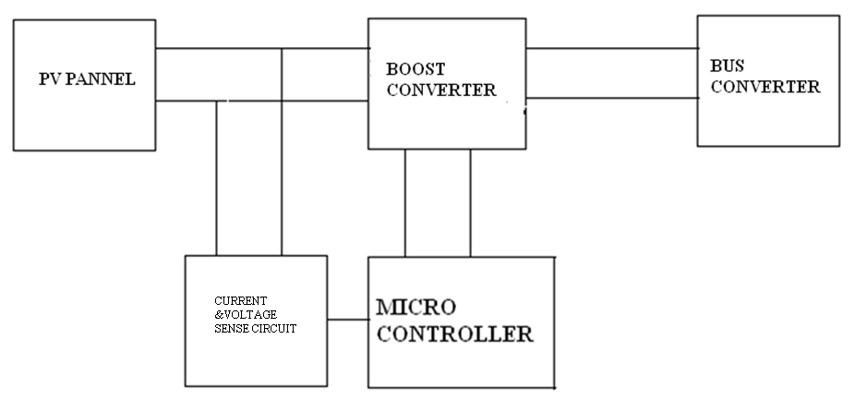
MPPT System Design

Slide 6
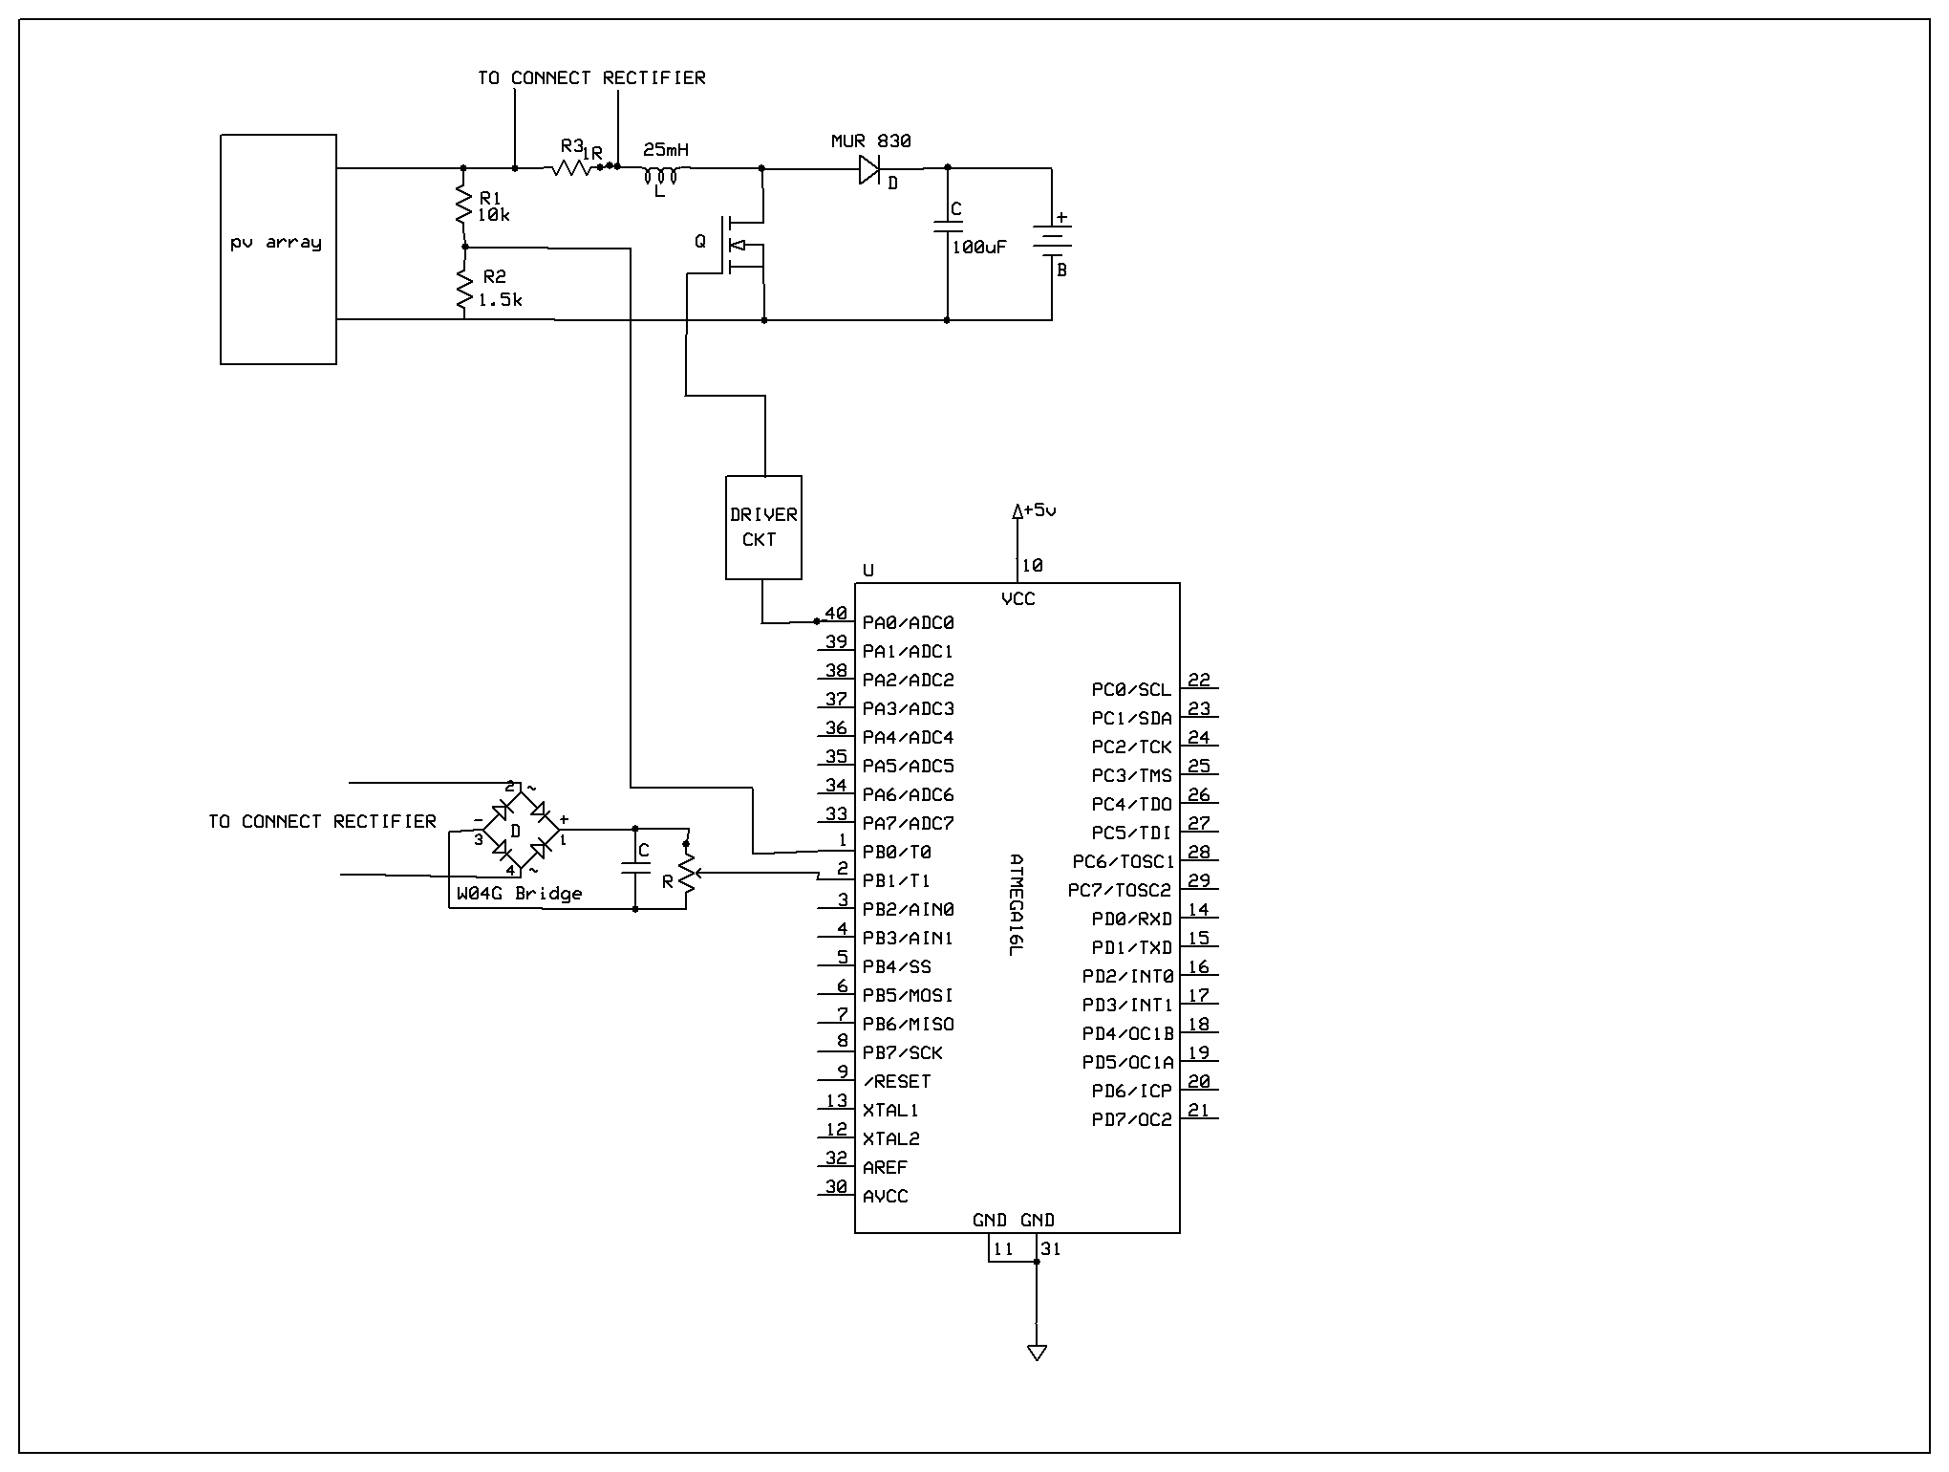
MPPT Schematic

Slide 7
Design of MPPT

Slide 8
Reference Voltage

Slide 9
Design…..
The Input parameters are

Slide 10
Design…..

Slide 11
Design…..

Slide 12
Design…..

Slide 13
Design…..
From the input parameters,

Slide 14
Design…..

Slide 15
Design…..

Slide 16
Design…..

Slide 17
Mppt Waveforms

Slide 18
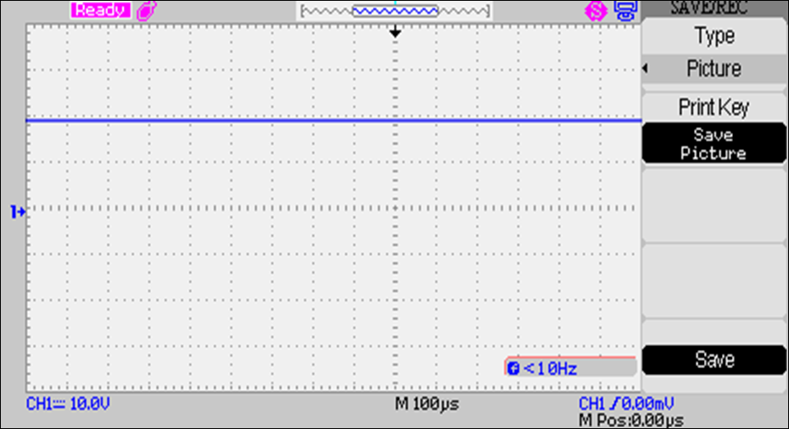
PV Voltage

Slide 19
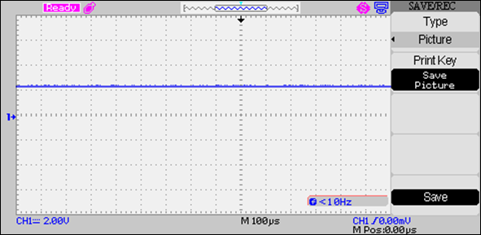
Reference Voltage

Slide 20
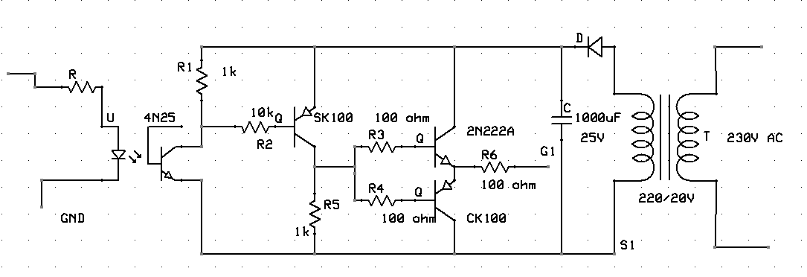
Driver Circuit

Slide 21
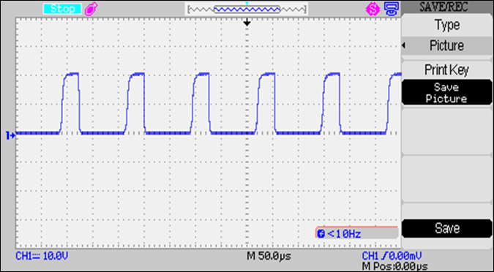
Output of MCT 2E

Slide 22
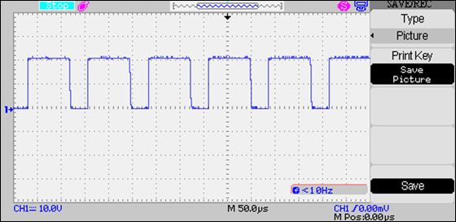
Transistor SK 100 Output

Slide 23
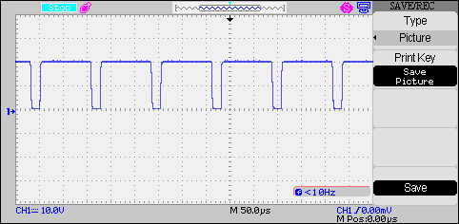
MPPT Pulse

Slide 24
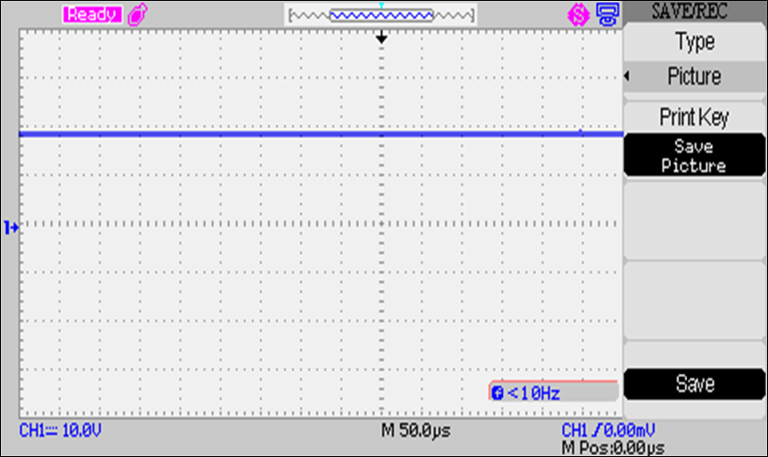
MPPT Output

Slide 25
Performance of mppt

Slide 26
MPPT…..
PV VOLTAGE | EFFICIENCY
18.35 | 81
18.33 | 79
18.31 | 77
18.26 | 81
18.21 | 95
18.06 | 81
17.49 | 78

Slide 27
MPPT…..
PV VOLTAGE

Slide 28
Bus Converter

Slide 29
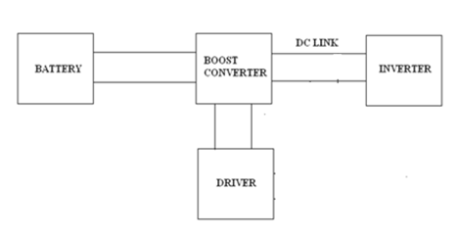
Bus Converter System Design…..

Slide 30
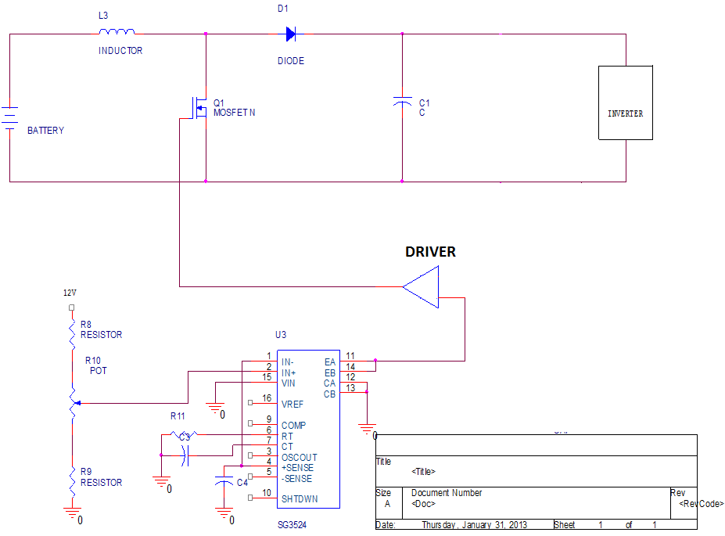
Bus Converter Schematic

Slide 31
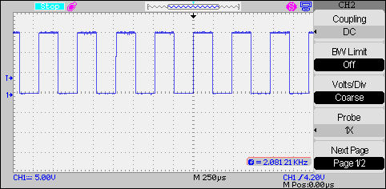
Bus Converter Pulse

Slide 32
Bus Converter Design

Slide 33
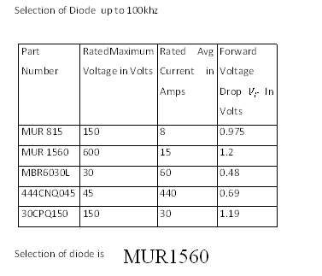
Diode Design…..

Slide 34
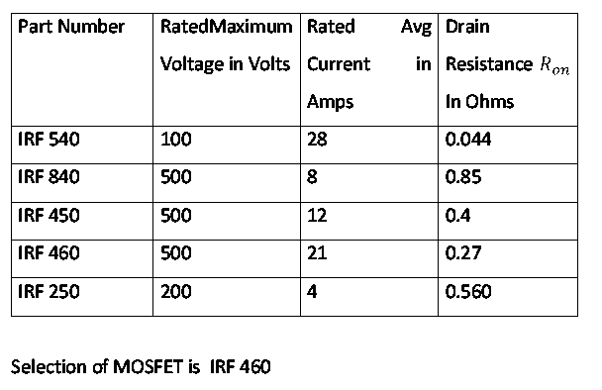
Selection of MOSFET

Slide 35
Design…..

Slide 36
Design…..

Slide 37
Design…..

Slide 38
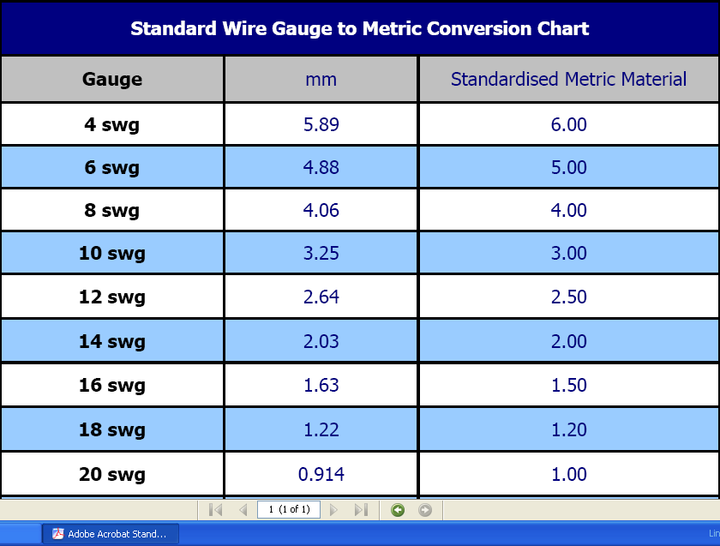
Gauge Selection

Slide 39
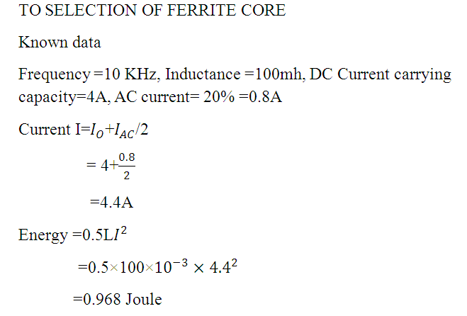
Inductor Core Design

Slide 40
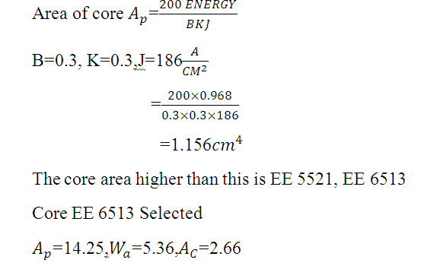
Design…..

Slide 41
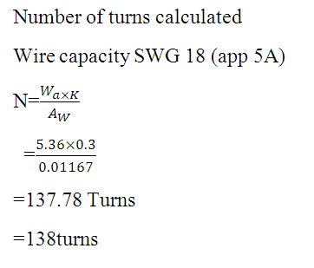
Design…..

Slide 42
Inverter

Slide 43
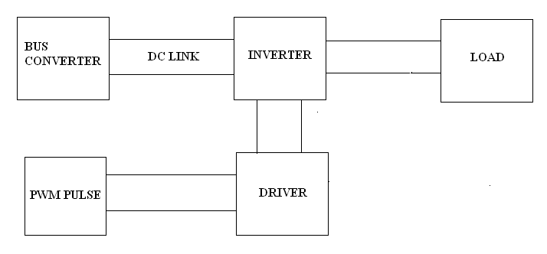
Inverter System Design

Slide 44
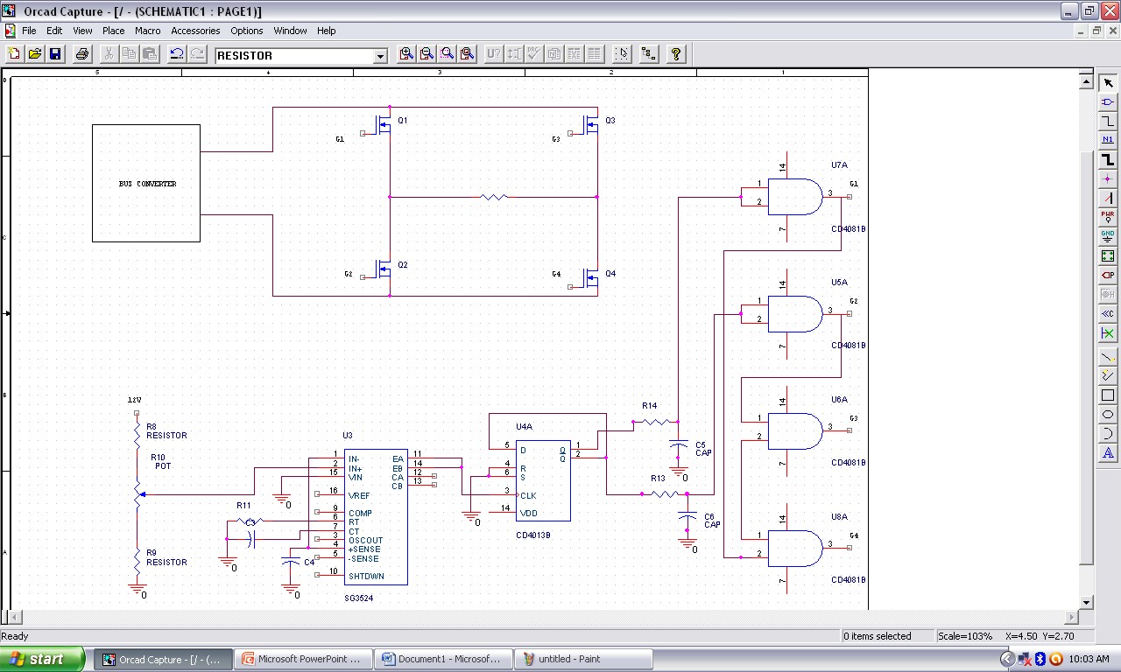
Inverter Schematic

Slide 45
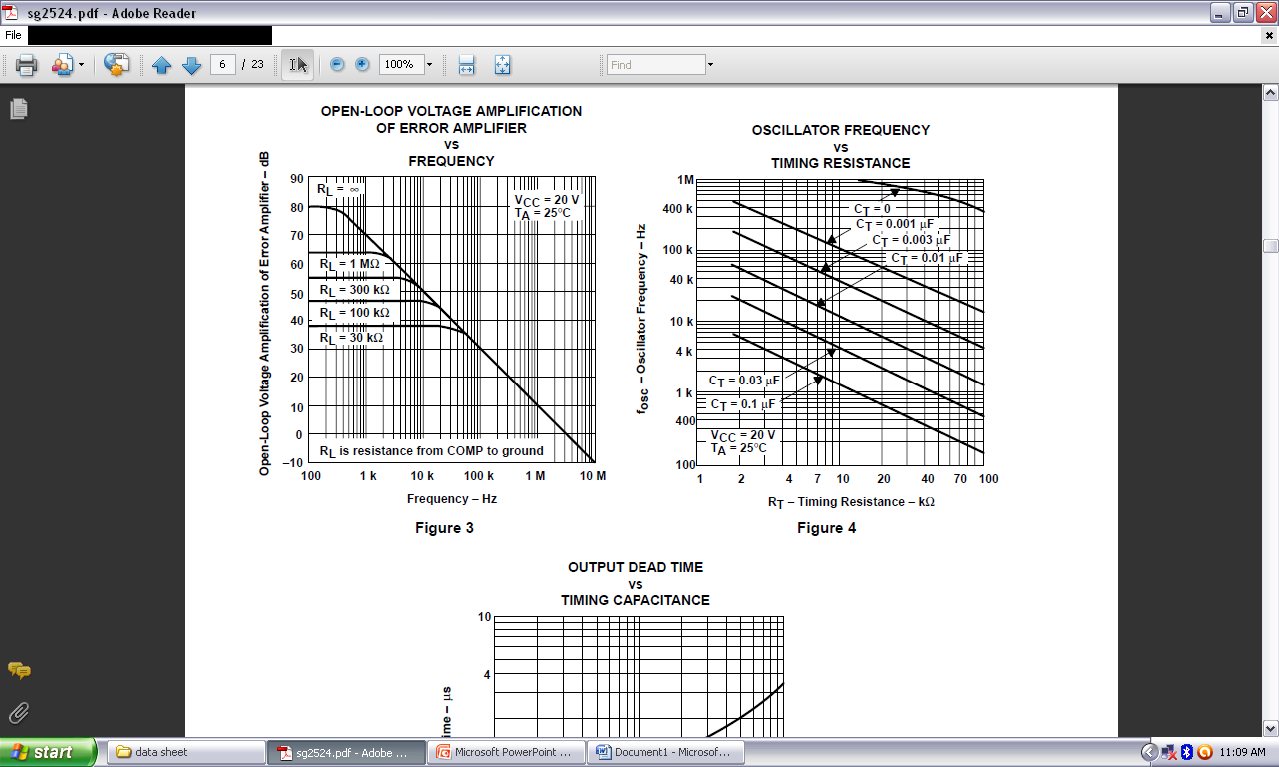
SG3524

Slide 46
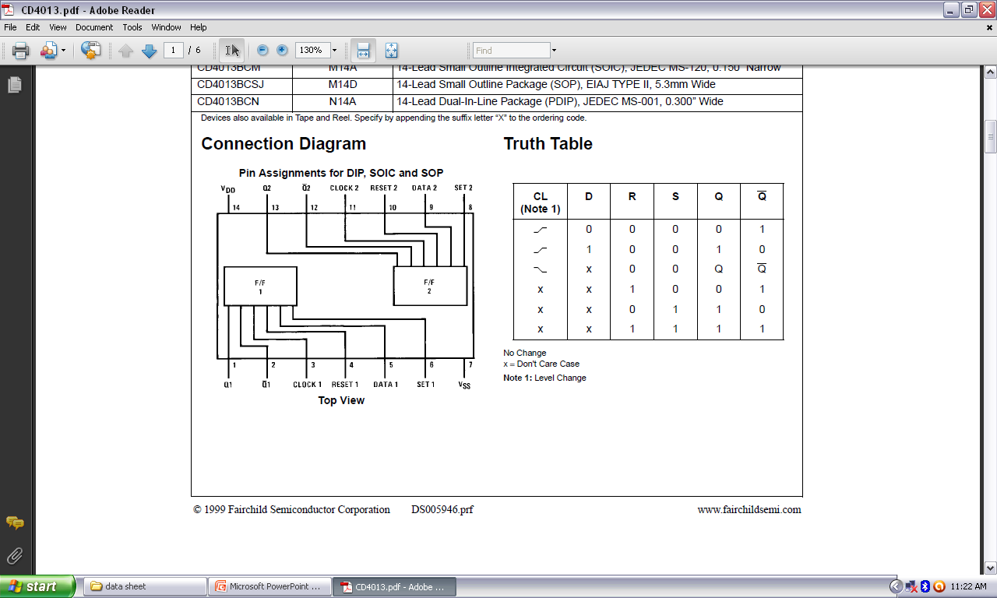
CD 4013 Pin Diagram

Slide 47

Truth Table

Slide 48
Performance of Inverter

Slide 49
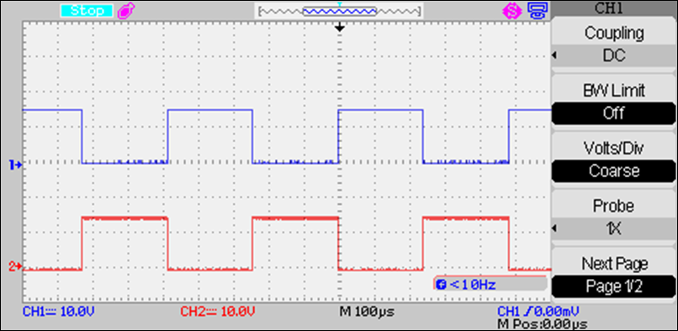
CD4013…..

Slide 50
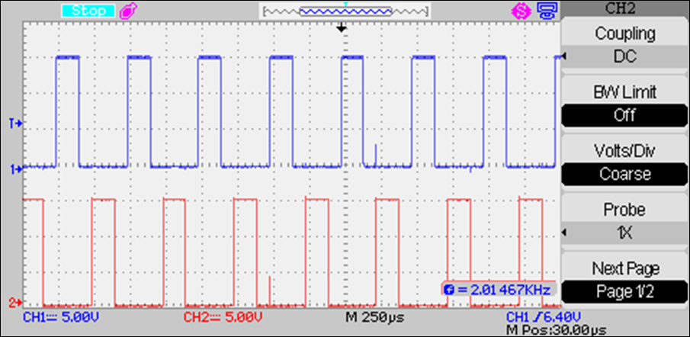
Inverter Pulse

Slide 51
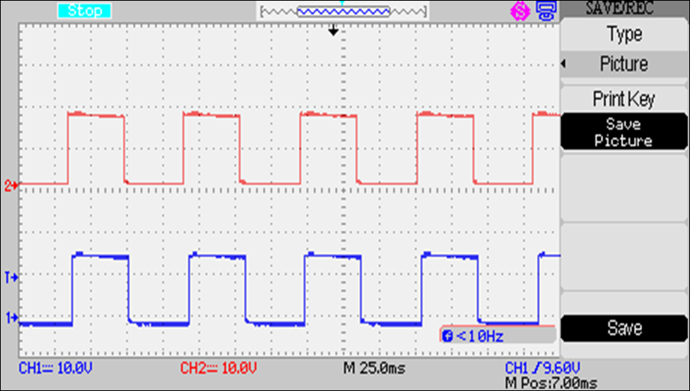
15 Degree Phase Shift Pulse S1 & S2

Slide 52
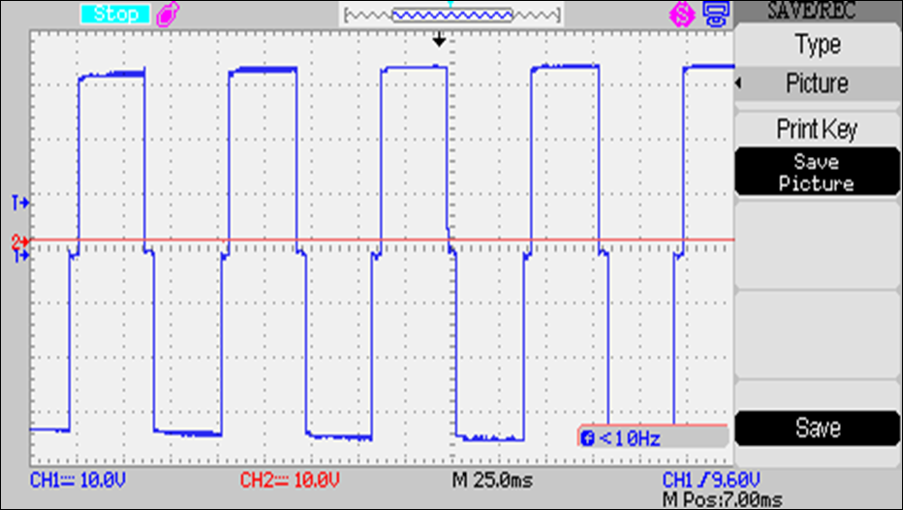
15 Degree Phase Shift Output

Slide 53
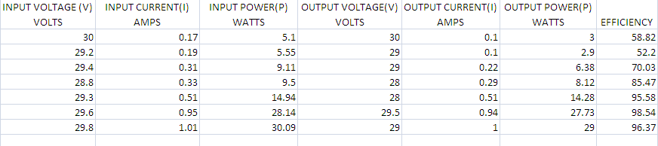
15 Degree Phase Shift
Maximum Efficiency = 98.54

Slide 54
15 Degree Phase Shift

Slide 55
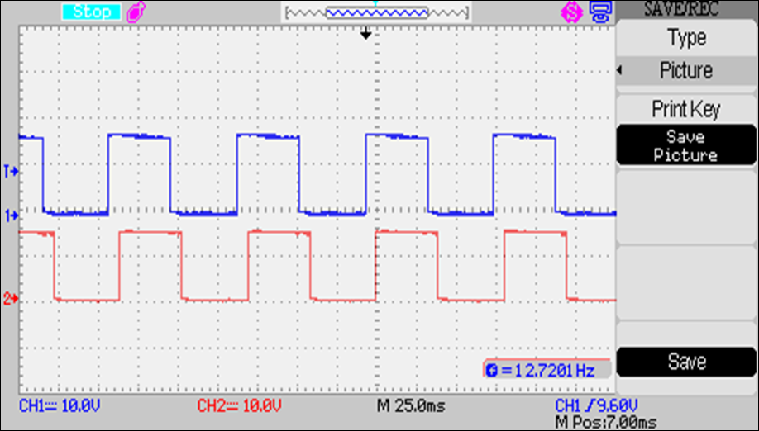
30 Degree Phase Shift Pulse S1 & S3

Slide 56
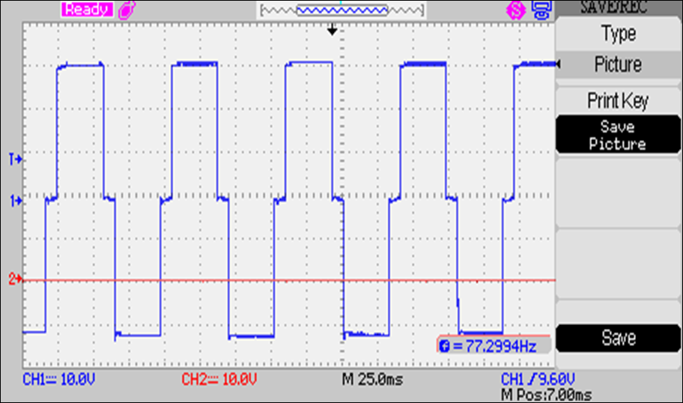
30 Degree Phase Shift Output

Slide 57
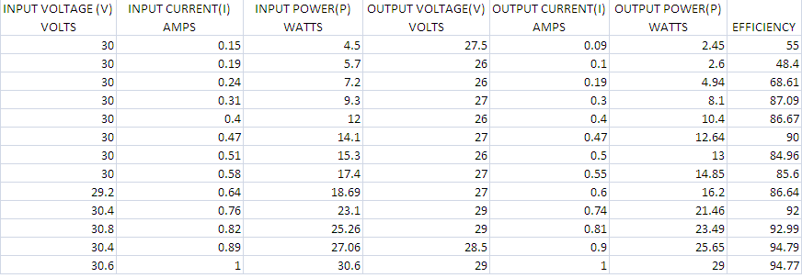
30 Degree Phase Shift
Maximum Efficiency = 94.79

Slide 58
30 Degree Phase Shift

Slide 59
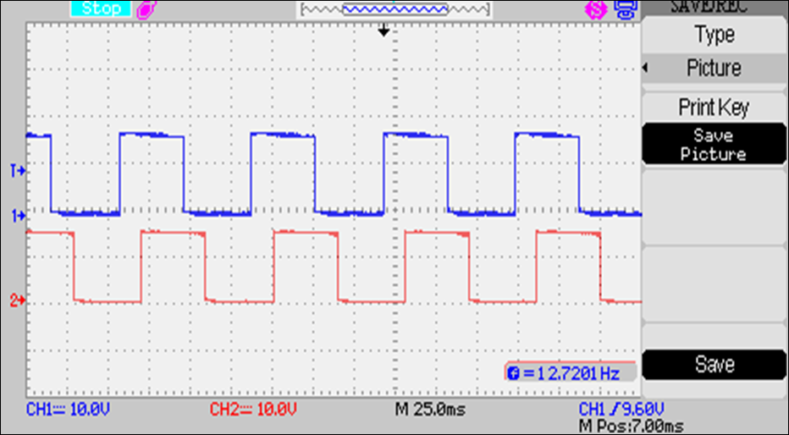
60 Degree Phase Shift Pulse S1 & S3

Slide 60
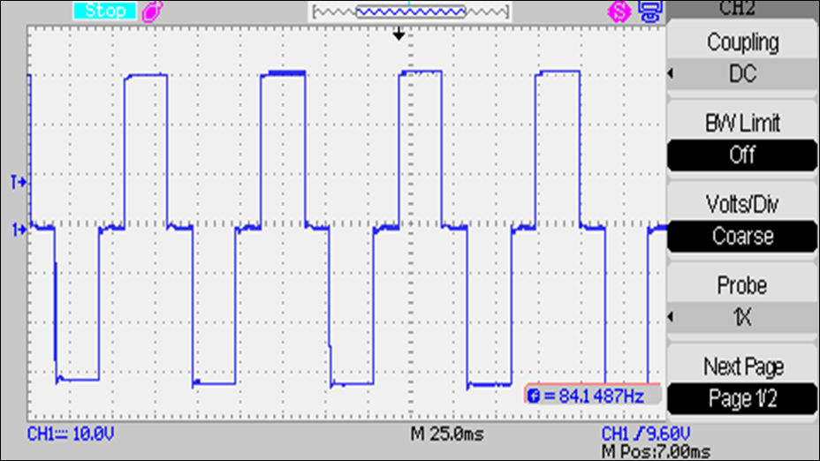
60 Degree Phase Shift Output

Slide 61
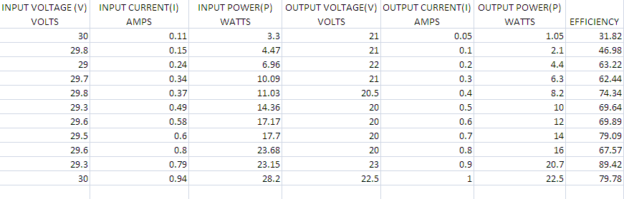
60 Degree Phase Shift
Maximum Efficiency = 89.42

Slide 62
60 Degree Phase Shift

Slide 63
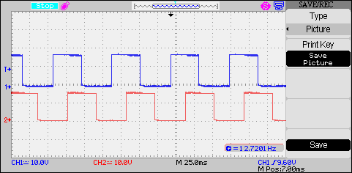
90 Degree Phase Shift Pulse S1& S3

Slide 64
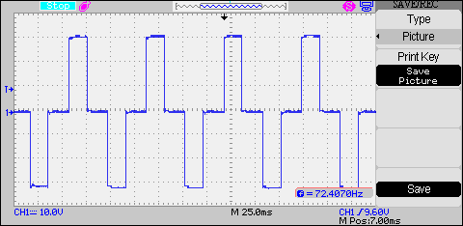
90 Degree Phase Shift Output

Slide 65
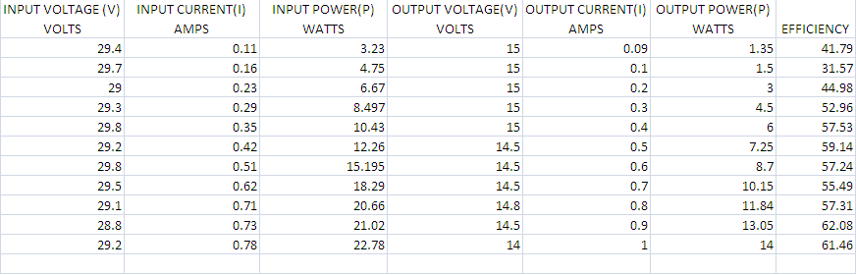
90 Degree Phase Shift
Maximum Efficiency = 62.08

Slide 66
90 Degree Phase Shift

Slide 67
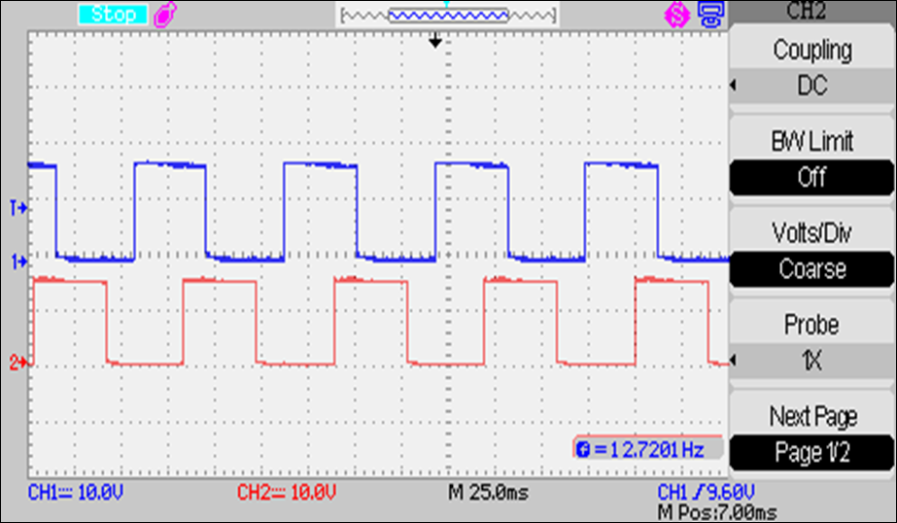
120 Degree Phase Shift Pulse S1 & S3

Slide 68
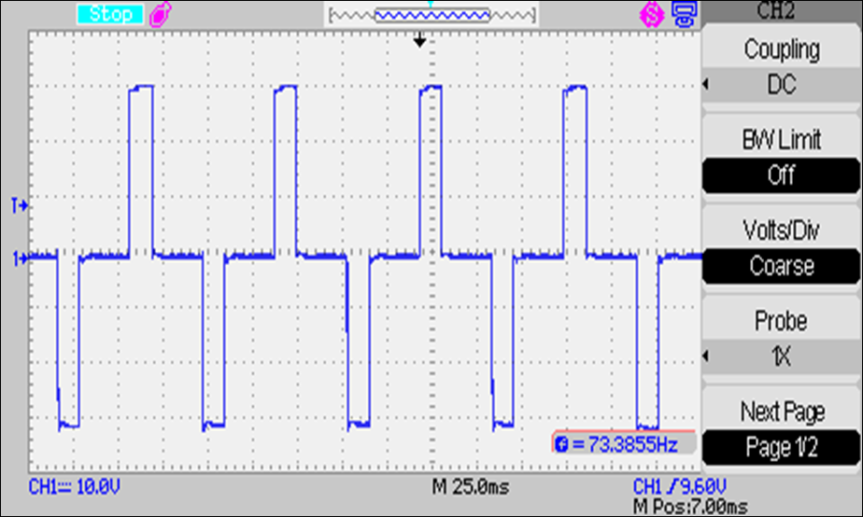
120 Degree Phase Shift Output

Slide 69
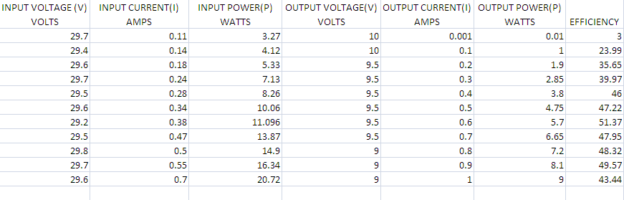
120 Degree Phase Shift
Maximum Efficiency = 51.37

Slide 70
120 Degree Phase Shift

Slide 71
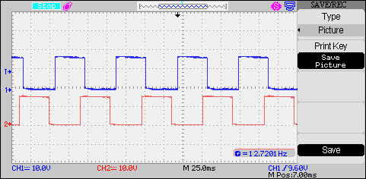
150 Degree Phase Shift Pulse S1& S3

Slide 72
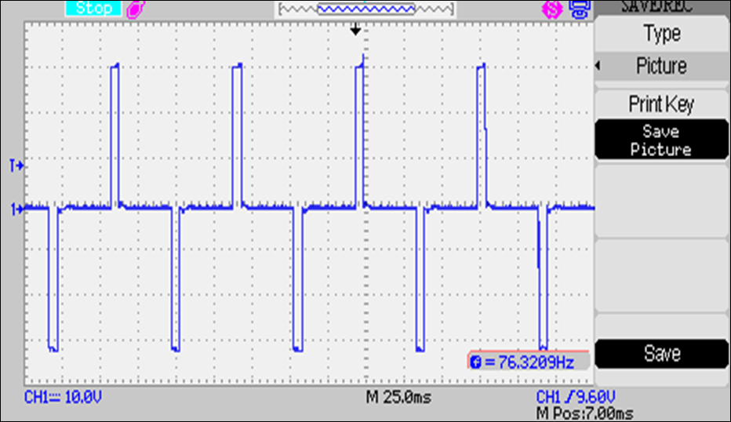
150 Degree Phase Shift Output

Slide 73
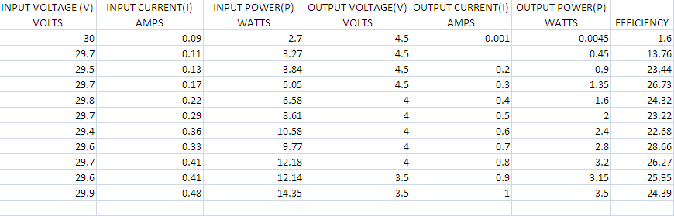
150 Degree Phase Shift
Maximum Efficiency = 28.66

Slide 74
150 Degree Phase Shift

Slide 75
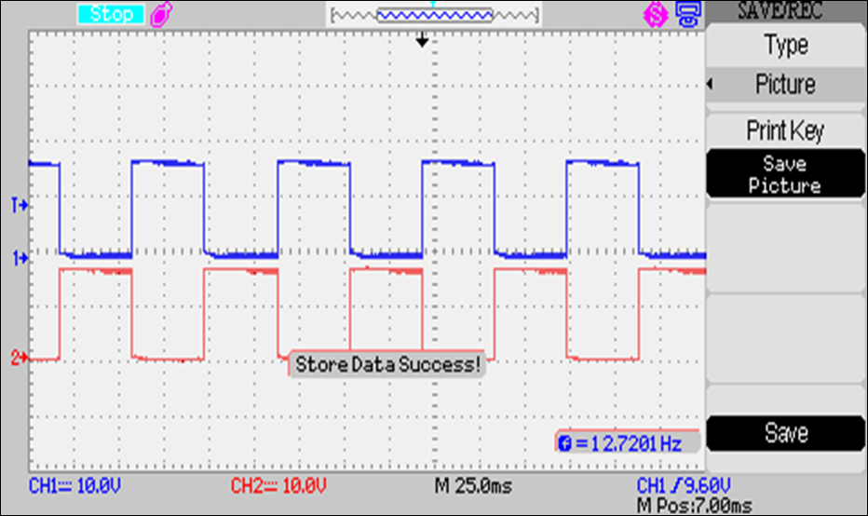
Hard Switching Pulses

Slide 76
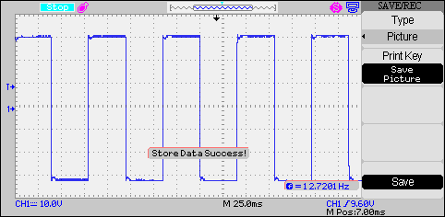
Hard Switching Output

Slide 77
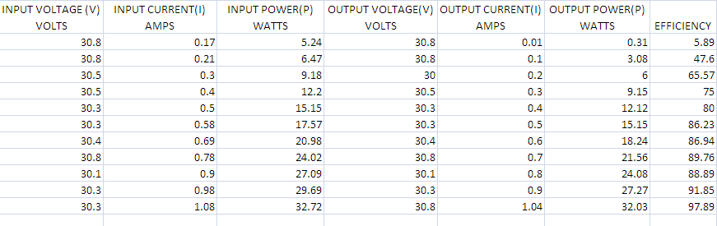
Hard Switching
Maximum Efficiency = 97.89

Slide 78
Hard Switching

Slide 79
Simulation

Slide 80
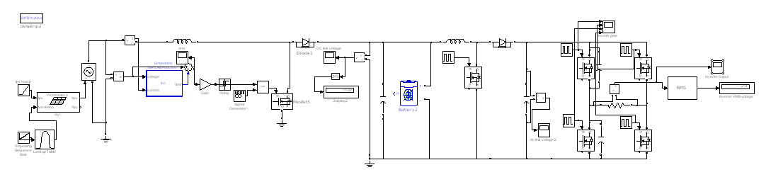
Simulation

Slide 81
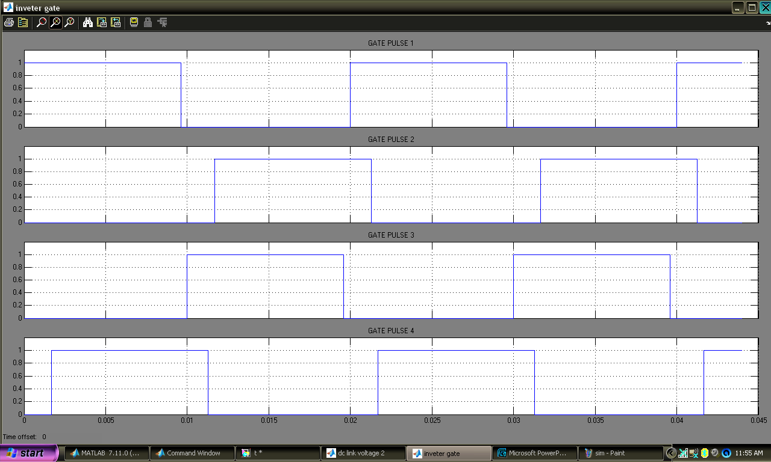
Inverter Gate Pulse

Slide 82
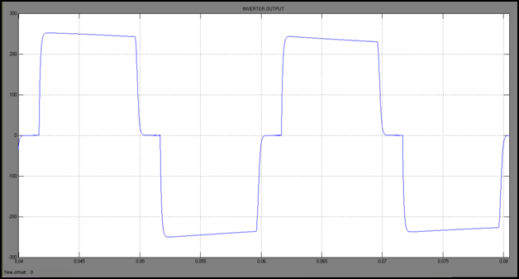
Inverter Output

Slide 83
Proceedings

Slide 84
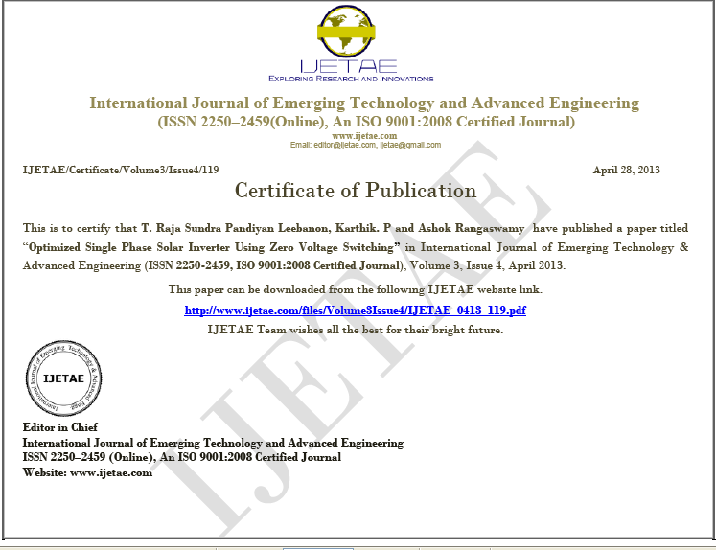
Proceedings…..

Slide 85
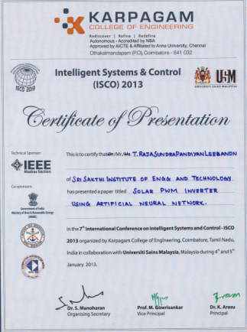
Proceedings…..

Slide 86

Proceedings…..

Slide 87
References

Slide 88
References…..
[1] Ashish Pandey, Nivedita Dasgupta & Ashok Kumar Mukerjee “High-performance Algorithm for Drift Avoidance and Fast Tracking in Solar MPPT System” IEEE Transaction, June 2008.
[2] Efticheos Koutroalis, Koastas Kalaitzakis, Nicholas C Voulgaris “Development of a Microcontroller-Based Photovoltaic Maximum Power Point Tracking Control System” IEEE Transaction, Jan 2001.
[3] Cesare Alippi “ An Adaptive System for Optimal Solar Energy Harvesting in wireless sensor nodes” IEEE Transaction, July 2008
[4] N. Femia, G. Petrone, G. Spagnolo and M. Vitelli, “Increasing the Efficiency of P&O by Converter Dynamic Matching”, 35th Annual IEEE Power Specialists Conference, Aachen, Germany, 2004.
[5] J. Youngseok, S. Junghun, Y. Gwonjong and C. Jaeho, “Improved Perturbation and Observation Method (IP&O) of MPPT Control for Photovoltaic Power Systems”, The 31st Photovoltaic Specialists Conference, Lake Buena Vista, Florida, pp. 1788 – 1791, 3-7 January 2005.
[6] B. Amrouche, M. Belhamel and A. Guessoum, “Maximum Power Point Tracking Acceleration by using Modified P&O Method for Photovoltaic Systems”, Second International Congress on Environment and Renewable Energies, Mahdia, Tunisia, 6-8 November 2006.
[7] S. Premrudeepreechachain and N. Patanapirom, “Solar Array Modeling and Maximum Power Tracking Using Neural Networks”, IEEE Power Tech Conference, Bologna, Italy, PP. 53 – 68, 23-26 June 2003.

Slide 89
References…..
[8] B. Amrouche and B Kazed, “Multilayered Neural Network Adaptive Controller for Robot Manipulators”, 1st International Conference on Dextrous Autonomous Robot and Humanoids, Yverdon-les-bains, Swittzerland, May 19-22, 2005.
[9] J. A. Sabate, V. Vlatkovic, R. B. Ridley, F. C. Lee, and B. H. Cho, “Design considerations for high-voltage high-power full-bridge zerovoltage switched PWM converter,” in Conf. Rec. IEEE APEC’90, 1990,pp 275-284
[10] J. G. Cho, J. W. Baek, D. W. Yoo, H. S. Lee, and G. H. Rim, “Zero voltage and zero current switching full bridge PWM converter using transformer auxiliary winding,” in Conf. Rec. IEEE PESC’97, 1997,pp. 227–232.
[11] K. K. Tse, M. T. Ho, H. Chung, and S. Y. R. Hui, “A novel maximum power point tracker for PV panels using switching frequency modulation,” IEEE Trans. Power Electron., vol. 17, no. 6, pp. 980–989.

Slide 90
Thank You

